Slide 1

TOPIC 3: HUMAN RESOURSE PLANNING AND RECRUITMENT

Slide 2

1. HR planning process

Slide 3

Human resource planning is a process through which the company anticipates future business and environmental forces.

Slide 4

CATEGORIES OF EMPLOYEES

Slide 5
Category | Decisions to be taken regarding
Existing employees | performance appraisal
 | productivity
 | deployment
 | equal opportunities
 | education and training
 | remuneration
 | promotion an career development
New employees | recruitment sources and methods
 | selection procedure
 | terms of employment
 | induction
 | one-the-job and additional training
Potential employees | recruitment sources and methods
 | public relation (PR)
 | remuneration levels
 | employee benefits
Leavers | dismissal for inadequate performance
 | retirement
 | redundancy procedure
 | employee turnover

Slide 6

HR PLANNING PROCESS

Slide 7
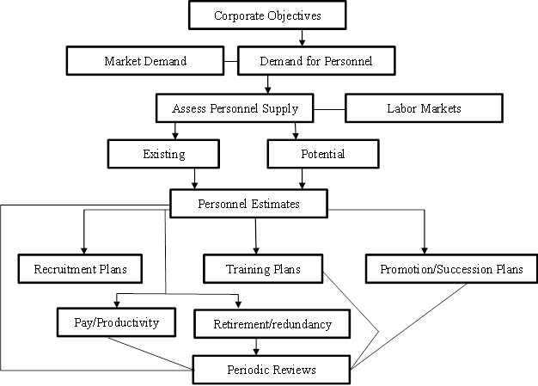

Slide 8

Major steps involved in human resource planning
Assessing Human Resources
Demand Forecasting
Supply Forecasting
Matching Demand And Supply
Action Plan

Slide 9
2.Factors that influence job choice

Slide 10
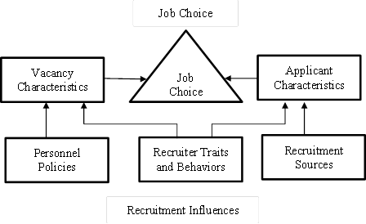

Slide 11

VACANCY CHARACTERISTICS:
Pay level. Pay is important because a person’s job is typically the primary source of his or her income.

Slide 12

Challenge and responsibility
The challenge and level of responsibility of a job are often important characteristics affecting choice.​

Slide 13

Job security
Job security is the probability that an individual will keep his or her job; a job with a high level of job security is such that a person with the job would have a small chance of becoming unemployed

Slide 14

Advancement opportunities
Having opportunities to advance within the organization is important to most people, especially applicants for managerial and professional vacancies. ​

Slide 15

Geographic location
Some job applicants have strong preferences for where they want to work. An example is someone who needs to stay in (or move to) a particular area because his or her spouse works there. ​

Slide 16

Employee benefits
Benefits are a large and ever-increasing expense for most employers and they frequently figure heavily in published ratings of the “best companies to work for”.

Slide 17

CHARACTERISTICS OF INDIVIDUALS
Non-compensatory decision processes. They are simply means that one vacancy characteristic is so important to that person that any job vacancy that fails to meet the person’s standard on that characteristics will not be considered – regardless of the job’s standing on the other dimensions.

Slide 18

Compensatory decision processes
Once the job field has been narrowed using non-compensatory standards, individuals tend to engage in a more refined decisions process that allows for compensatory relationships among factors. The individuals seek to determine which of the various acceptable vacancies is most attractive.​

Slide 19

The implicit favorite
Some researchers have speculated that job seekers use a complex compensatory process like that described by expectancy theory for a small number of jobs in order to arrive at an “implicit favorite”. ​

Slide 20

Individual differences in job choice
Individuals with little experience in job hunting may employ only non-compensatory processes and accept the first job they find acceptable. Individuals with more experience may spend a lot of time analyzing in detail many jobs yet still be reluctant to call off the search for new implicit favorites.​

Slide 21

What Factors Influence a Career Choice?

Slide 22
When we think about career choice, several things immediately come to mind – job description, training and education required, career outlook, and salary – but there are a number of other factors that may influence your decisions. Let's explore some of these factors as addressed by multiple career development theories. Theories can help us frame why and how things happen. In this case, career development theories help us explain why and how we choose to pursue specific career fields

Slide 23

Childhood Fantasies
What do you want to be when you grow-up? You may remember this question from your childhood, and it may have helped shape how you thought about careers then, as well as later in life. Career counseling theories are expanding as programs related to career choice are developed for all ages, including the very young. Ginzberg proposed a theory that describes three life stages related to career development. The first stage, fantasy, where early ideas about careers are formed, takes place up to age 14

Slide 24

Culture
Racial and ethnic background, as well as the culture of an individual's regional area, local community, and extended family, may impact career decisions. Our culture often shapes our values and expectations as they relate to many parts of our lives, including jobs and careers. Multicultural career counseling has emerged as a specialized field to take these influences into consideration when counseling clients and students. We can’t attribute the predominant characteristics of a culture to any one of its individuals, but having an awareness of the values and expectations of our culture may help us understand how we make our career choices.

Slide 25

Gender
Both men and women have experienced career-related stereotypes. Gender is a factor included in multiple career development theories and approaches including, Social Learning and multicultural career counseling. How we view ourselves as individuals may influence both the opportunities and barriers we perceive as we make career decisions. Studies of gender and career development are ongoing as roles of men and women in the workforce, and in higher education, evolve.

Slide 26

Interests
Holland's Career Typology is a widely used to connect personality types and career fields. This theory establishes a classification system that matches personality characteristics and personal preferences to job characteristics. The Holland Codes are six personality/career types that help describe a wide range of occupations.

Slide 27

Life Roles
Being a worker is just one of your life roles, in addition to others such as, student, parent, and child. Super's Lifespan theory directly addresses the fact that we each play multiple roles in our lives and that these roles change over the course of our lives. How we think about ourselves in these roles, their requirements of them, and the external forces that affect them, may influence how we look at careers in general and how we make choices for ourselves.

Slide 28

Personality Type
Understanding your Personality Type can assist your career development in a number of ways.
1) It can help you select a career field that is a good fit for your personality make-up.
2) It can increase your awareness of your learning style so you can better benefit from career related education.
3) Understanding your personality preferences can help you better manage Job Challenges that inevitably rise their ugly heads during the course of our career.
4) Knowing your Personality Type, and especially knowing the specific details of your individual type can provide, will aid you in a job search, both in marketing yourself and in evaluating opportunities that arise.

Slide 29

Previous Experiences
Having positive experiences and role models working in specific careers may influence the set of careers we consider as options for ourselves. One aspect of Social Cognitive Career Theory addresses the fact that we are likely to consider continuing a particular task if we have had a positive experience doing it. In this way, we focus on areas in which we have had proven success and achieved positive self-esteem

Slide 30

Skills, Abilities, & Talents
Considering your skills, abilities and talents and how they may fit a particular occupation comes out of one of the earliest career development fields, Trait-Factor theories, and is still used today. These theories recommend creating occupational profiles for specific jobs as well as identifying individual differences, matching individuals to occupations based on these differences. You can identify activities you enjoy and those in which you have a level of competency though a formal assessment.

Slide 31

Social and Economic Conditions
All of our career choices take place within the context of society and the economy. Several career theories, such as Social Cognitive Career Theory and Social Learning, address this context in addition to other factors. Events that take place in our lives may affect the choices available to us and even dictate our choices to a certain degree. Changes in the economy and resulting job market may also affect how our careers develop.

Slide 32
3.The role of HR recruitment

Slide 33
The goal of an organizational recruitment program is to ensure that the organization has a number of reasonably qualified applicants (who would find the job acceptable) to choose from when a vacancy occurs.

Slide 34

❶Internal vs. External Recruitment
An internal recruitment is characterized by promoting employees from within an organization to fill upcoming positions.

Slide 35

METHODS OF INTERNAL RECRUITMENT
Internal advertisement
Promotion
Transfer
Reemployment of former employees
Employees hired earlier on the contract basis or for part- time work.
Retired employees

Slide 36

An external recruitment
is one which a human resources department will systematically search the employee pool outside its own employees to fill positions. ​

Slide 37
EXAMPLES OF SUCH RECRUITMENT:
Campus Recruitment​
Job Portals​
Job fairs and seminars​
Waiting lists​
Employment Exchanges​
Job consultancies​
References and recommendations​
Direct Walk-ins​
Ads on newspaper, magazines, and website, etc​

Slide 38
COMPARISON CHART
BASIS FOR COMPARISON | INTERNAL RECRUITMENT | EXTERNAL RECRUITMENT
Meaning | Internal Recruitment involves recruiting candidates from those who are already in employment within the organization. | When the recruitment of candidates is done externally, then this type of recruitment is known as external recruitment.
Basis | Merit with seniority | Merit with qualification
Time taken | Less | Comparatively more
Induction training | Not required | Must
Cost | It is a cost effective process | It is a costly process
Alternatives | Limited | Many

Slide 39
Internal Recruitment | External Recruitment
Advantages
Cheaper and quicker to recruit | Outside people bring in new ideas
People already familiar with the business and how it operates | Larger pool of workers from which to find the best candidate
Provides opportunities for promotion with in the business – can be motivating | People have a wider range of experience
Business already knows the strengths and weaknesses of candidates
Disadvantages
Limits the number of potential applicants | Longer process
No new ideas can be introduced from outside | More expensive process due to advertising and interviews required
May cause resentment amongst candidates not appointed | Selection process may not be effective enough to reveal the best candidate
Creates another vacancy which needs to be filled

Slide 40

Key Differences between Internal and External Recruitment
1. Internal Recruitment refers to a source of recruiting manpower which is already existing within the organization. External Recruitment is a little different as it involves the hunting of prospective employees from outside the organization.

Slide 41

2. Internal recruitment does not require induction training, whereas, in external recruitment, induction training is a must.

Slide 42

3. Internal Recruitment is faster than external recruitment because external recruitment involves stages like advertising and inviting applications, screening of applications, short listing, conducting an examination and interview, selection, placement, training, testing, induction, etc.

Slide 43


4. The basis for internal recruitment is merit cum seniority, but the basis of external recruitment is merit cum qualification.

Slide 44

5. Internal Recruitment is a cost effective process. However, External Recruitment requires a large amount of investment.

Slide 45

6. In internal recruitment, the choice is very limited which is not in the case of external recruitment.

Slide 46

❷Lead-the-market strategies
The pay is an important job characteristic for almost all applicants, companies that take a “lead-the-market” approach to pay – that is, a policy of paying higher-than-current market wages – have a distinct advantage in recruiting.

Slide 47

❸Employment-at-will Policies
At-will means that an employer can terminate an employee at any time for any reason, except an illegal one, or for no reason without incurring legal liability.

Slide 48

❹Image advertising
Organizations often advertise specific vacancies. Sometimes, however, organizations advertise just to promote themselves as good place to work, in general. Image advertising is particularly important for companies in highly competitive labor markets that perceive themselves as having a bad image.

Slide 49
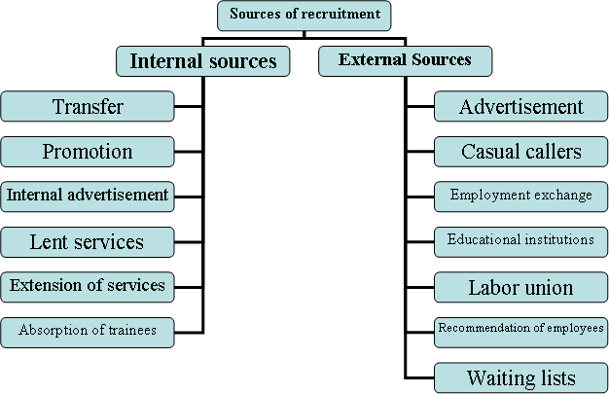

Slide 50

Five Life Hacks For Finding Your Dream Job

Slide 51

Life Hack #1: Find Your Strengths
What are you really good at? Do you thrive on creating strategic business plans? Are you a whizz with numbers? Begin by asking yourself some tough questions and writing down your top skills.
Once you have this information in hand, you can start searching for career paths that compliment and encourage the things that you’re naturally good at.

Slide 52

Life Hack #2: Reflect On Your Past Experiences & Aspirations
Start at the very beginning and go all the way back to childhood. What did you want to be as a child? You know, before the world told you that it wasn’t a good idea and before you doubted your own abilities.
Next, look at your past roles. What positions have you naturally gravitated towards? What aspects of your previous jobs did you enjoy? What ones did you avoid at all costs? What’s your most significant career achievement to date?
Reflecting on your career history can help identify recurring themes. Perhaps you realise that you’ve always enjoyed working as part of a team or mastering the written word. On the other hand, maybe you notice that you’ve always hated giving presentations. Not only will these insights help you get a bit closer to your dream job, but you’ll also be able to highlight any relevant experiences when it’s time to draft a new CV.

Slide 53

Life Hack #3: Enrol in Classes
Taking a class, whether at your local University or online, lets you try something new. Who knows maybe you’ll even discover a new career path?!

Slide 54

Life Hack #4: Follow Your Passion
Following your passion may sound like clique advice, but it’s better than doing a job you hate. Defining your dream job essentially comes down to finding a career that you love so much that work doesn’t feel like work. The key is identifying this passion and then using it to shape your career path.
One way to go about finding your passion or dream job is to find a job you’d be willing to do for free. Imagine that you don’t get paid, or at least don’t get paid very well, would you still go to work?
Know the answer? Presto, you’ve found your dream job! Think about it -- if you’re so passionate about something that you’d do it for free, then getting paid to do it would be the ultimate definition of a dream job. It may not be the best paid or most prestigious job, but it’ll certainly be challenging and fulfilling.

Slide 55

Life Hack #5: Speak to One of Our Consultants
Let us change the way you think about your job. Our specialist recruitment professionals have over 45 years of experience within the accountancy and finance, investment management and asset servicing, IT, professional services, risk and compliance, and construction industries. We have access to some of the best jobs within these industries and are experts at helping talented candidates find new, life-changing positions.

Slide 56
Lection is over! Thank you for your attention!

